Slide 1
Learning Session 2
Overview of ‘C’(control) from the D-M-A-I-C Model

Slide 2

The presence of the Laboratory African Regional Collaboration (LARC) logo on slides
indicates that content (in whole or in part) originates with the LARC Program

Slide 3
Control
LARC Workbook, p. 77-84
https://www.larccqi.org/uploads/resources/LARC-3.0-WORKBOOK.pdf
LARC Workbook

Slide 4
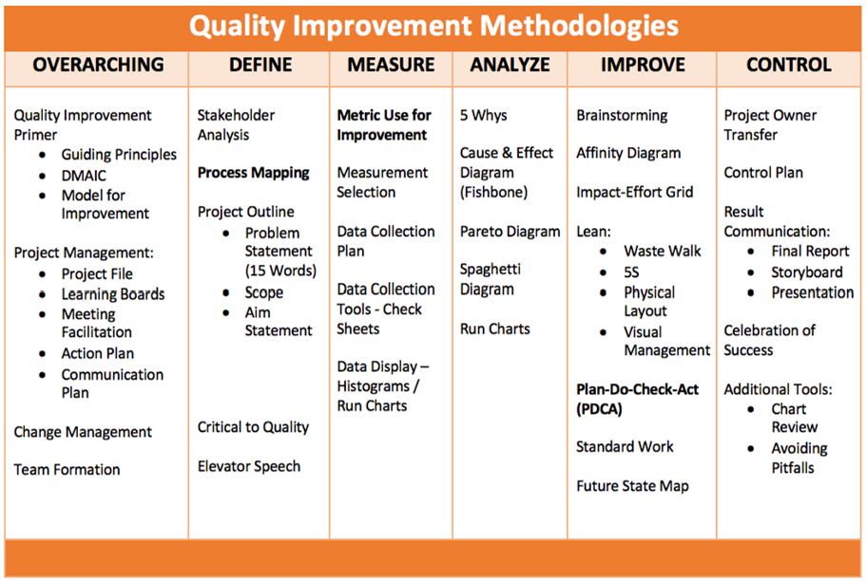
LARC Workbook

Slide 5
Define
Measure
Analyze
Improve
Control
Objectives Tools
Ensure sustainability
  Hand over to process owner
  Control Plan
Communicate
  Document the project
  Share results
Spread Improvement
Celebrate
Control Plan
Assessment/Performance Dashboard
Project closure documentation
LARC Workbook

Slide 6
Project Deliverables
Learning Session 1
DEFINE / MEASURE / ANALYZE
Learning Session 2
IMPROVE / CONTROL
Identify Stakeholders
Team Formation
Map the Process (Current)
Identify/Prioritize Opportunities
  Project Outline
Baseline Metrics - Data Collection Tool/Plan
Action Plan
Elevator Speech
Root Cause Analysis
1 Rapid/Small Test of Change (PDSA)
Presentation
  Update Project Outline, if necessary
1 5S Exercise
1 Visual Management Application
2 or more Tests of Change (PDSA)
Select and Implement Change
Modify Solution(s) where necessary by additional Test of Change (PDSA)
Create Future State Map
Create Standard Work
Presentation
LARC Workbook

Slide 7
Control Plan
LARC Workbook, p. 78-79
https://www.larccqi.org/uploads/resources/LARC-3.0-WORKBOOK.pdf
LARC Workbook

Slide 8
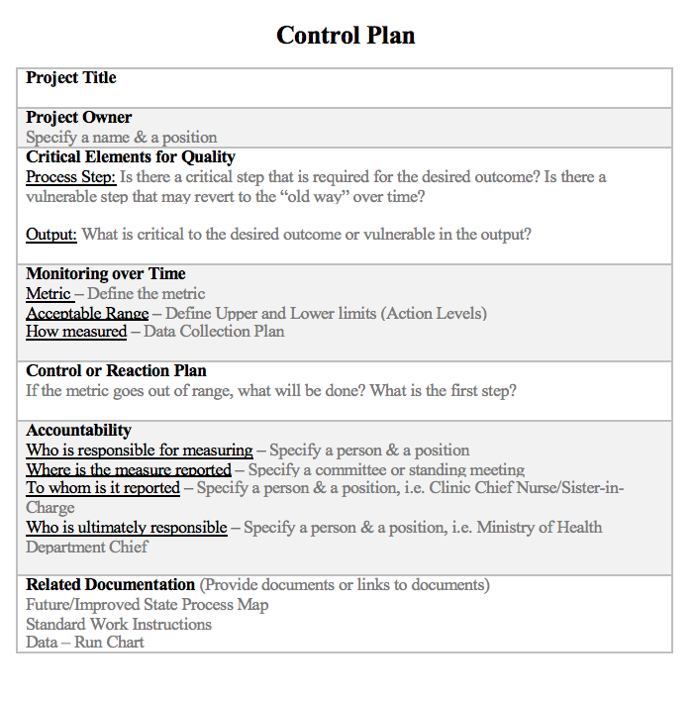
Control Plan
Continuous Touch Points
LARC Workbook, p. 78-79
https://www.larccqi.org/uploads/resources/LARC-3.0-WORKBOOK.pdf
LARC Workbook
Notes:
Walk through the control plan form the Workbook, p. 79. explaining each section. During the faculty group work, assist each team to complete their control plan and add to the final report.

Slide 9
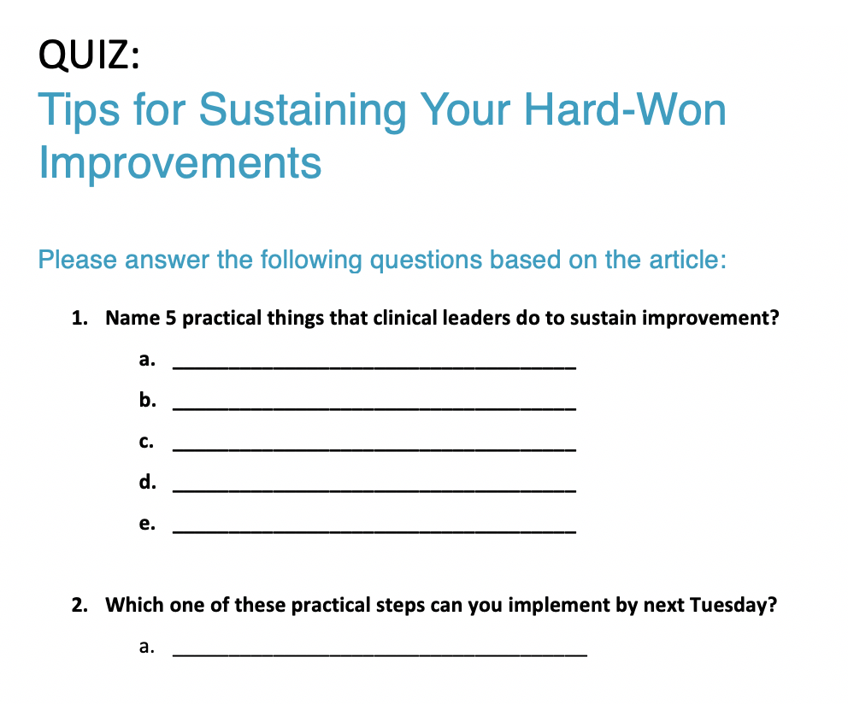

Sustain the Gains
LARC Workbook

Slide 10
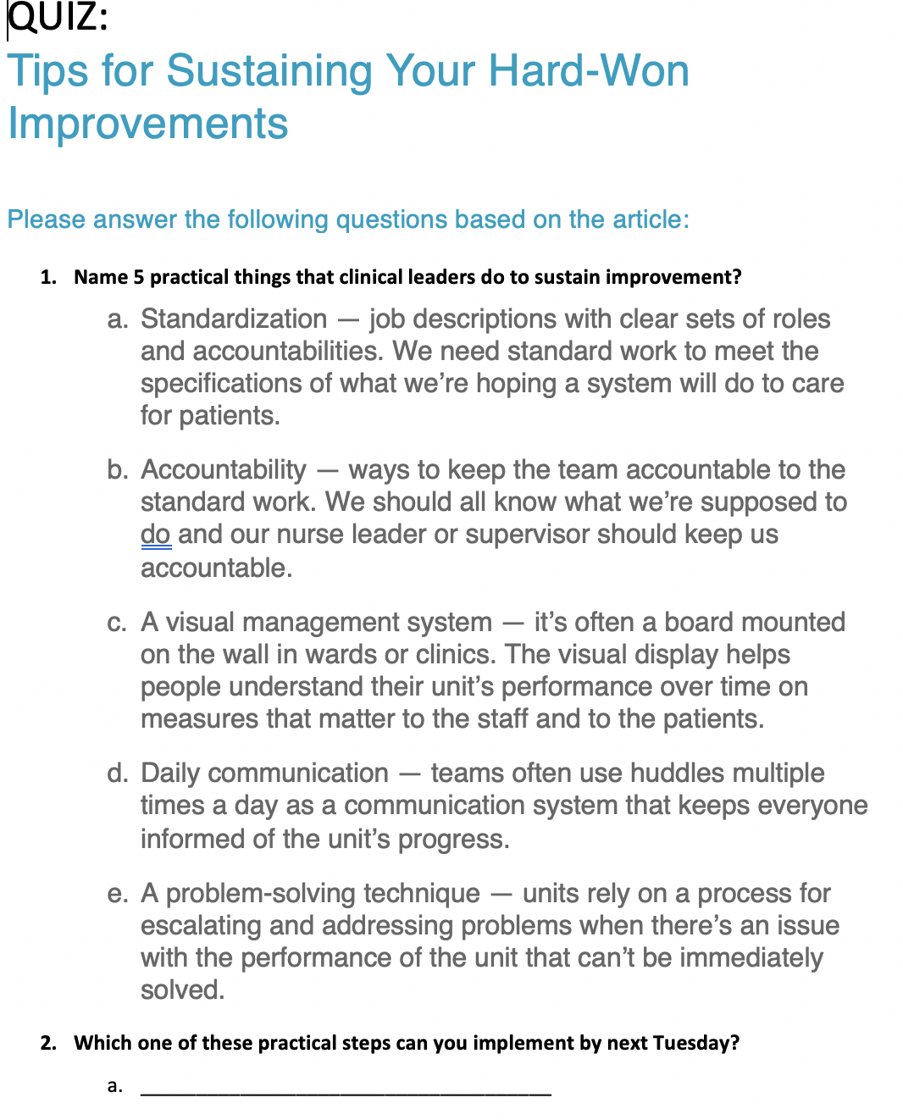
LARC Workbook
Notes:
Talk through each of the 5 practical things that clinical leaders can do to sustain improvement.

Slide 11
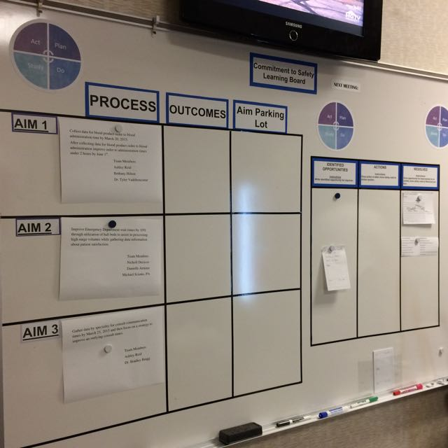
Project – Just Do It
Two sides of the
Learning Board:
Project
Just Do It
LARC Workbook

Slide 12
LEARNING BOARD
PROJECT |  |  | JUST DO IT
Aim / Metric | Changes |  | Identified Opportunities | Actions | Resolved
LARC Workbook

Slide 13
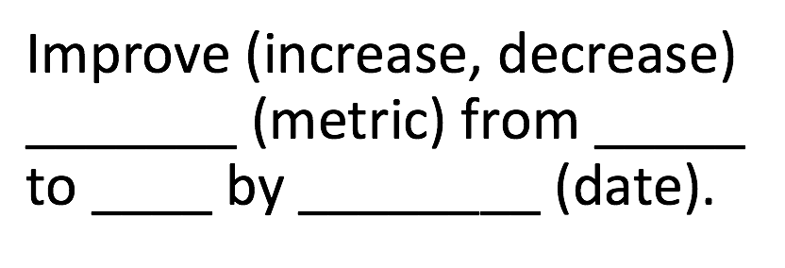
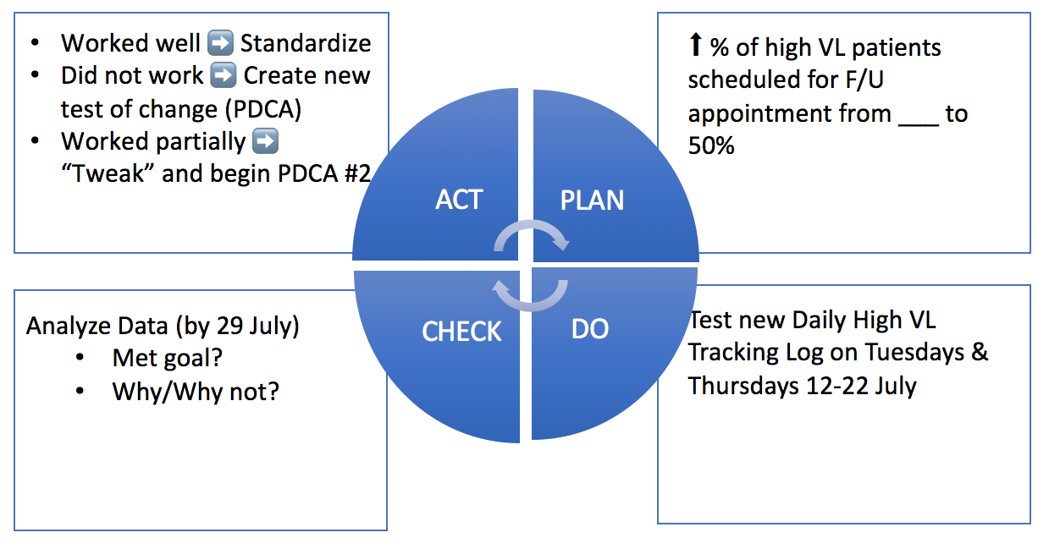
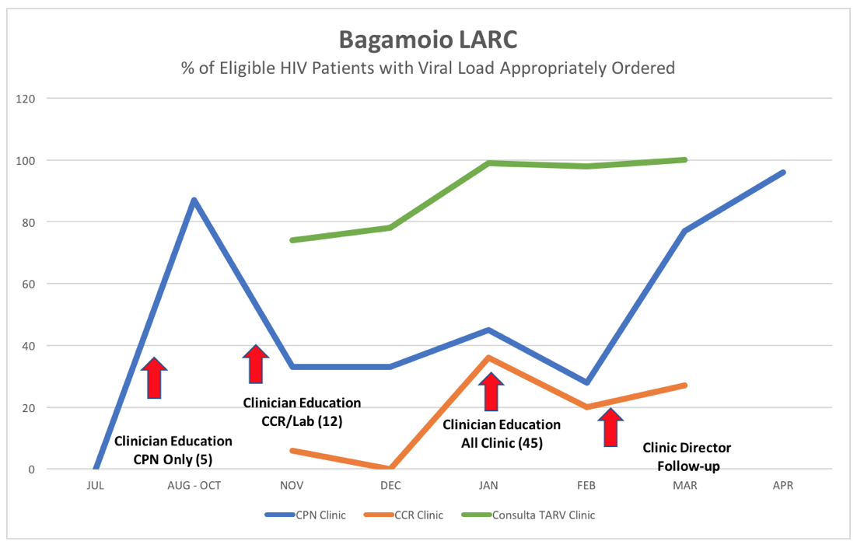
LEARNING BOARD
PROJECT |  |  | JUST DO IT
Aim / Metric | Changes |  | Identified Opportunities | Actions | Resolved
LARC Workbook

Slide 14
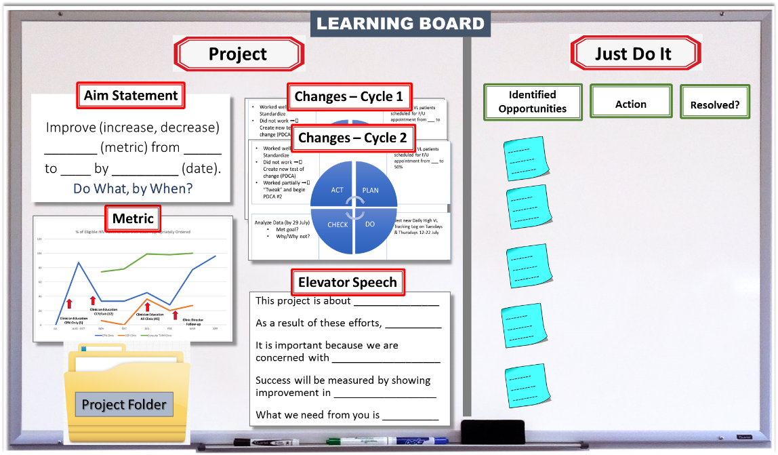
LARC Workbook

Slide 15
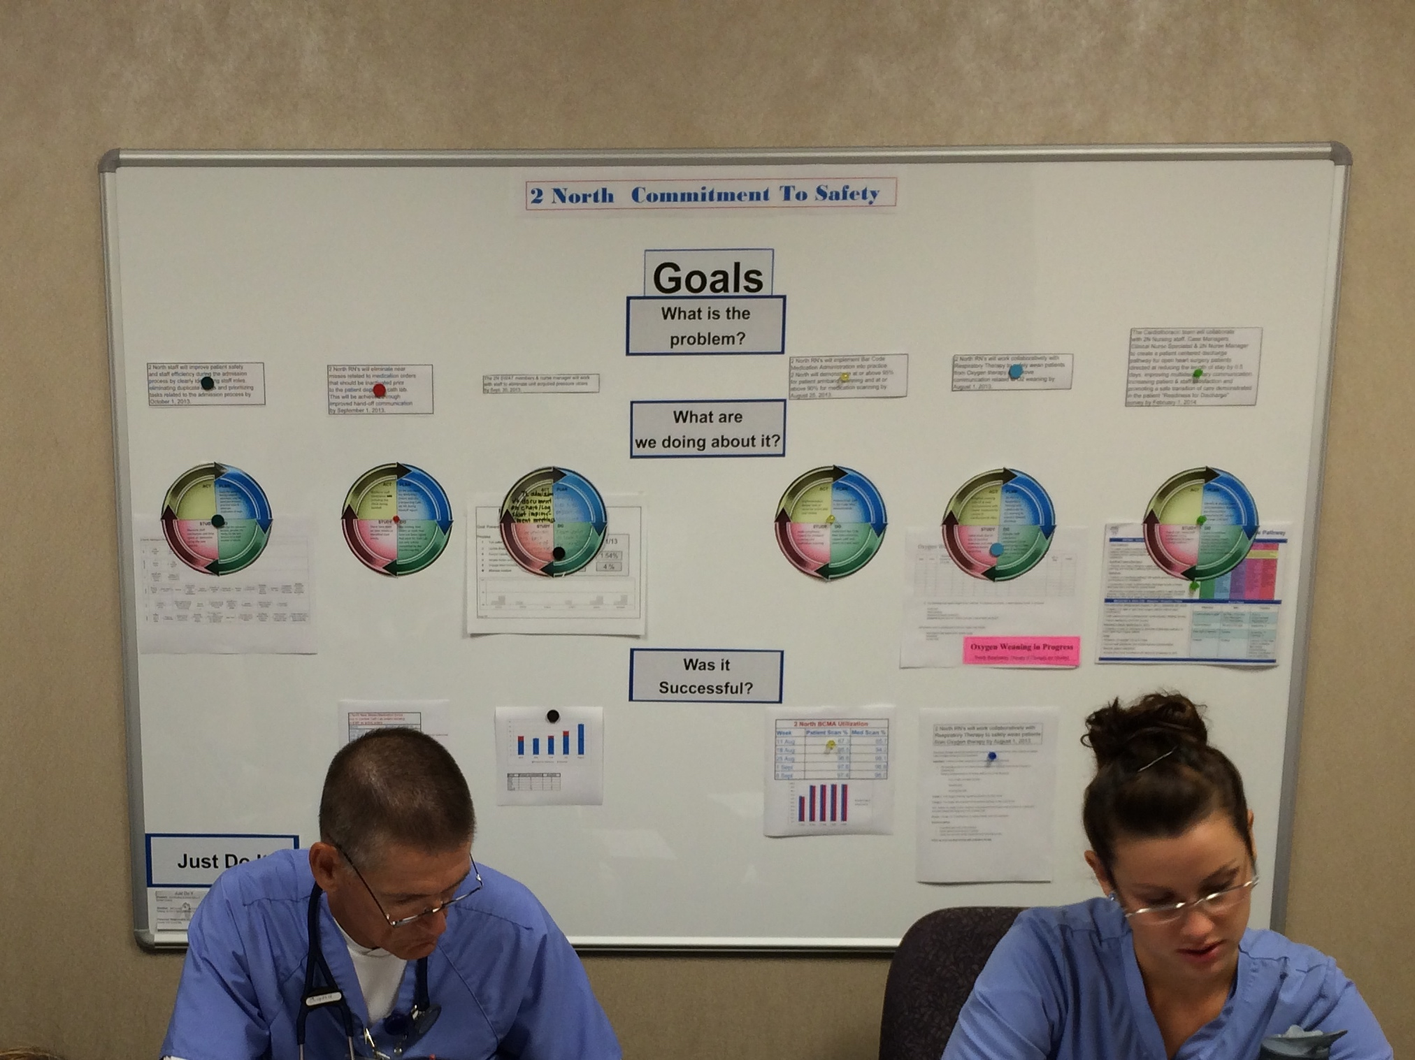
LARC Workbook

Slide 16
Define
Measure
Analyze
Improve
Control
Objectives Tools
Ensure sustainability
  Hand over to process owner
  Control Plan
Communicate
  Document the project
  Share results
Spread Improvement
Celebrate
Control Plan
Assessment/Performance Dashboard
Project closure documentation
LARC Workbook

Slide 17
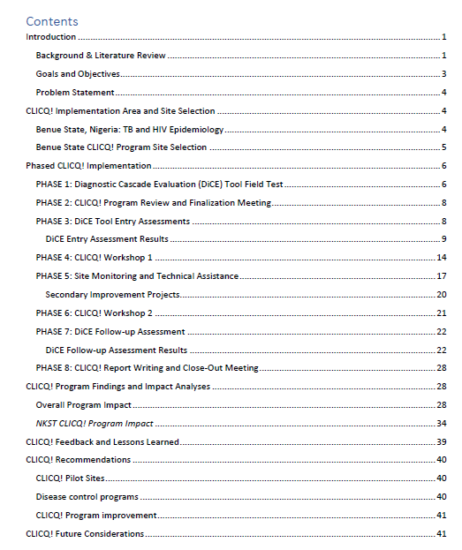

Project Closure Documents

Slide 18
Sharing Your Story
Convince the Stakeholders
Present Your Project
Publication
Notes:
If you happen to meet your key stakeholder/s and only have a quick 5 minutes, then you need to have your elevator speech honed and ready to “Convince the Stakeholders”.
If you are asked to provide a CPD or a 10 minute presentation to your facility or leadership – sharing what you have accomplished in your project – then you will need to “Present Your Project”.
For further communication, “Publication” may be necessary.
Choose from the above formats based on what you want to accomplish, your situation, and the time given.

Slide 19
Convince the Stakeholder
Making your story meaningful and impactful
LARC Workbook, p. 83-84
https://www.larccqi.org/uploads/resources/LARC-3.0-WORKBOOK.pdf
LARC Workbook

Slide 20
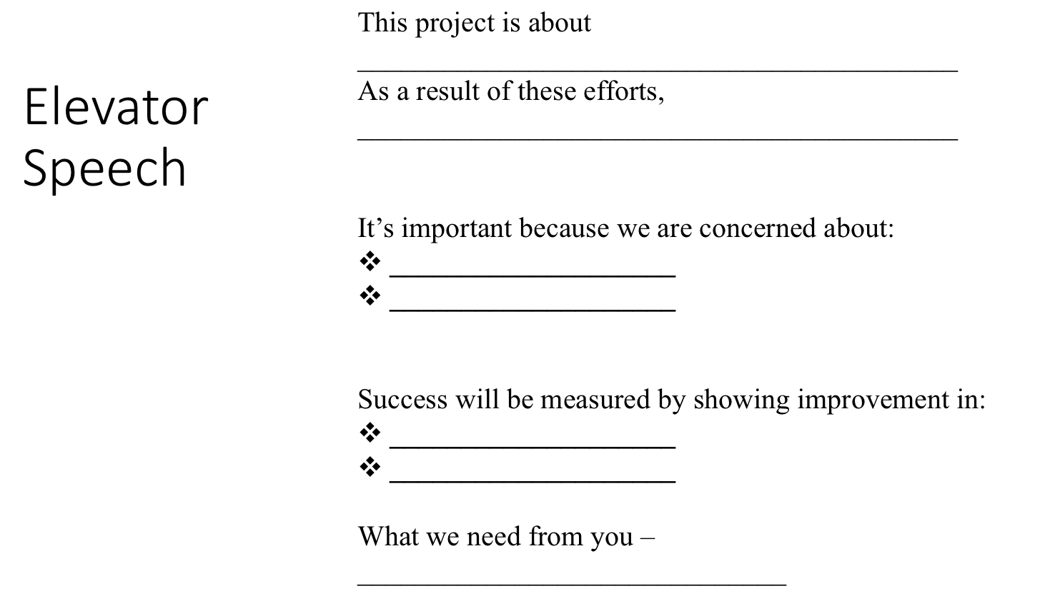
Activity
Convince the Stakeholder
30 min: Working as a team, revise & update your elevator speech, tailoring to address your assigned stakeholder.
  Distracted Minister
  Indifferent Governor
  Busy Local Politician
  Busy Hospital/Clinic Administrator
5 min: Role play with your assigned stakeholder
10 min: Debrief with the group
What you will need:
LARC Workbook, p. 83-84
https://www.larccqi.org/uploads/resources/LARC-3.0-WORKBOOK.pdf
LARC Workbook
Notes:
Ground rules
Each team will be given 15 minutes to rewrite/refine and practice their elevator speech in order to convince a stakeholder.
The stakeholder and the conditions under which the participants will play out the role will be selected by the faculty.
Teams will choose their representative who will try and convince the stakeholder about their project.
Each team will be given five minutes (strictly enforced) to participate in this role play and fully convince the stakeholder.
Use official language understood by all.
The LARC faculty will be judges of the role plays.
All comments from plenary will be made after all the groups have presented to save on time (20 minutes at the end of the session).

Slide 21
No | Facility | Stakeholder | Time
1 | Facility A | Disinterested Minister for Health that you met in an elevator | 5 Minutes
2 | Facility B | Indifferent Governor – Met in the corridor near his/her office returning from a meeting | 5 Minutes
3 | Facility C | Local Politician - Met in the lobby of the County Assembly Chambers on his/her way to meet the Governor | 5 minutes
4 | Facility D | Unconcerned Administrator - Met during his/her rounds at the Hospital | 5 minutes
5 | Facility E | Unconcerned Administrator - Summoned the team to his office because funding cuts will affect the care | 5 minutes
LARC Workbook
Notes:
Share with participants and stakeholders/actors prior to the activity.

Slide 22
Convince the Stakeholder - Ground Rules
Stick to time allocated
Use official language understood by all
The facilitators will be judges of this role play
All comments from plenary will be made after all the groups have presented
LARC Workbook

Slide 23
Present Your Project

Slide 24
Activity
Preparing to Present Your Project
Working as a team, select the 9-12 Slides from your Final PPT Project Report that you would present to your stakeholder when you share your story.
Remember, this is an opportunity to tell the story of your work and its importance – not a technical presentation!
Present your slide selections to the group.
What you will need:
Final PPT Project Report
Note paper & pen
15 minutes
LARC Workbook
Notes:
Emphasize that the final PPT project report is a complete report of all that your team has done and as such includes all the technical tools used.
For a report to your stakeholders, i.e., your Quality improvement team, CME for your facility, a report to your administrator, etc. - you will want to tell a compelling story, so select your slides carefully.
15 minutes allotted for group work.

Slide 25
Slide Titles in the Final PPT Report
Title
Team
Facility Background
Stakeholder Analysis
The Story of Our Project
Project Summary
DEFINE - Elevator Speech
DEFINE - Process Mapping
DEFINE - Problem Statement
MEASURE - Metric Selection - Baseline Data
MEASURE - Data Collection Process
ANALYZE - Fishbone
IMPROVE - Impact Effort Grid
IMPROVE - Just Do Its
IMPROVE - 5S
IMPROVE - Visual Management
IMPROVE - PDSAs
IMPROVE - Intervention
IMPROVE - Before/After Process Map
IMPROVE - Run Chart
CONTROL – Control Plan
Challenges
Successes
Lessons Learned
Action Plan
LARC Workbook
Notes:
Refer to your actual PPT Final Report
Select from these Slide Titles

Slide 26
Activity
Preparing to Present Your Project
Working as a team, select the 9-12 Slides from your Final PPT Project Report that you would present to your stakeholder when you share your story.
Remember, this is an opportunity to tell the story of your work and its importance – not a technical presentation!
Present your slide selections to the group.
What you will need:
Final PPT Project Report
Note paper & pen
15 minutes
LARC Workbook
Notes:
Emphasize that the final PPT project report is a complete report of all that your team has done and as such includes all the technical tools used.
For a report to your stakeholders, i.e., your Quality improvement team, CME for your facility, a report to your administrator, etc. - you will want to tell a compelling story, so select your slides carefully.
15 minutes allotted for group work.

Slide 27
Spread
Scale-up
Teach others
Notes:
As part of your next steps, discuss the future of the interventions and how they might be spread.

Slide 28
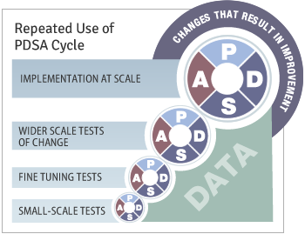
PDSA – Spread the Improvements
LARC Workbook

Slide 29

Celebrate
Congratulations!

Slide 30
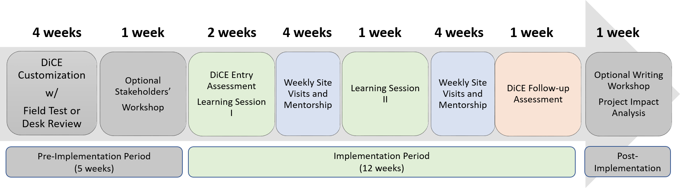
Upcoming
Mentorship Site Visits
DiCE Follow-up Assessments
NOTE: timeline estimates are only examples and can be modified depending on local context (e.g., program needs, available budget, and available expertise, etc.)
Notes:
Remind participants to prepare for mentorship visits and follow-up DiCE assessments

Slide 31
END OF LEARNING SESSION 2!
Improvement is Continuous…
What problem will you improve next?

Slide 32
Questions?

